Slide 1


UNIT-VI
Conflict and Stress Management
“Conflict Management” by
P. B. Narendra Kiran M.B.A., M.Phil., (Ph.D.)
Assistant Professor
Mittal School of Business, L.P.U., Phagwara, Punjab
Lecture-33

Slide 2


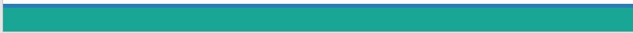

Slide 3

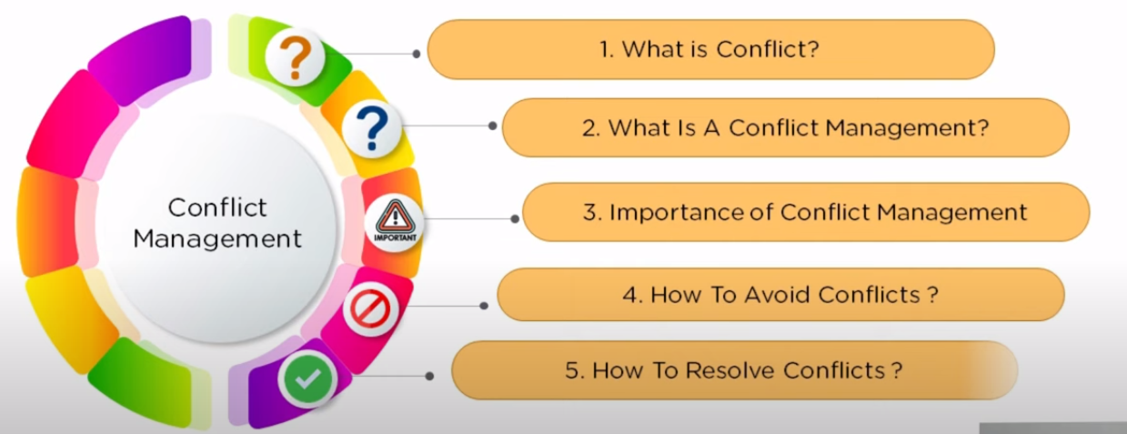
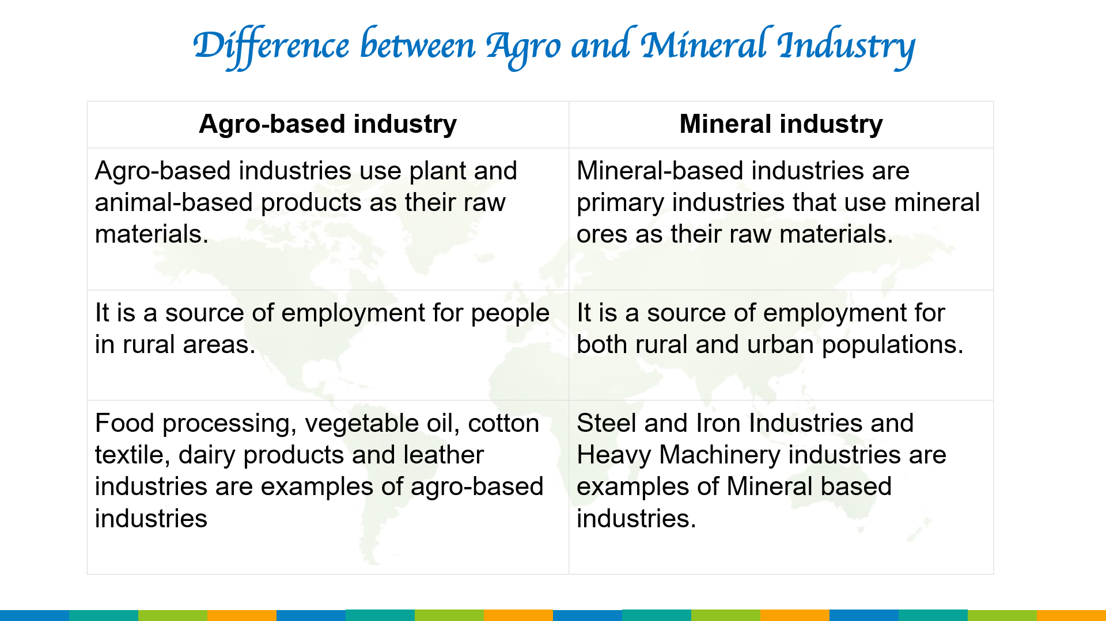
Objectives of the Study
Students will be able to learn

Slide 4
Introduction

Slide 5
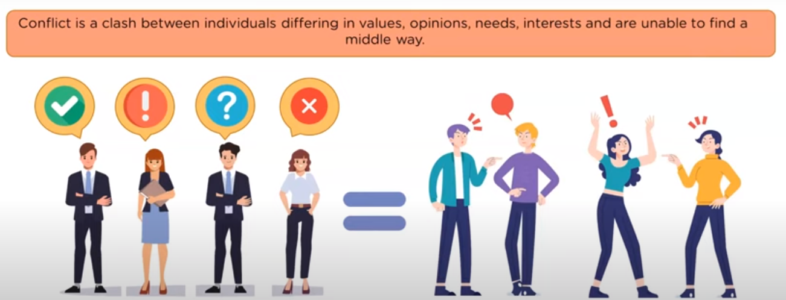
What is Conflict?
People with different ideas and opinions
Different Opinions and ideas leads to conflicts

Slide 6
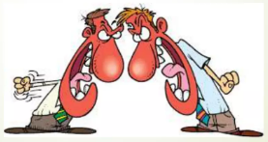
About Conflict
Conflict is a process that begins when one party perceives that another party has negatively affected, or is about to negatively affect, something that the first party cares about”.
Conflict is an inevitable and unavoidable part of our every day professional and personal lives.

Slide 7
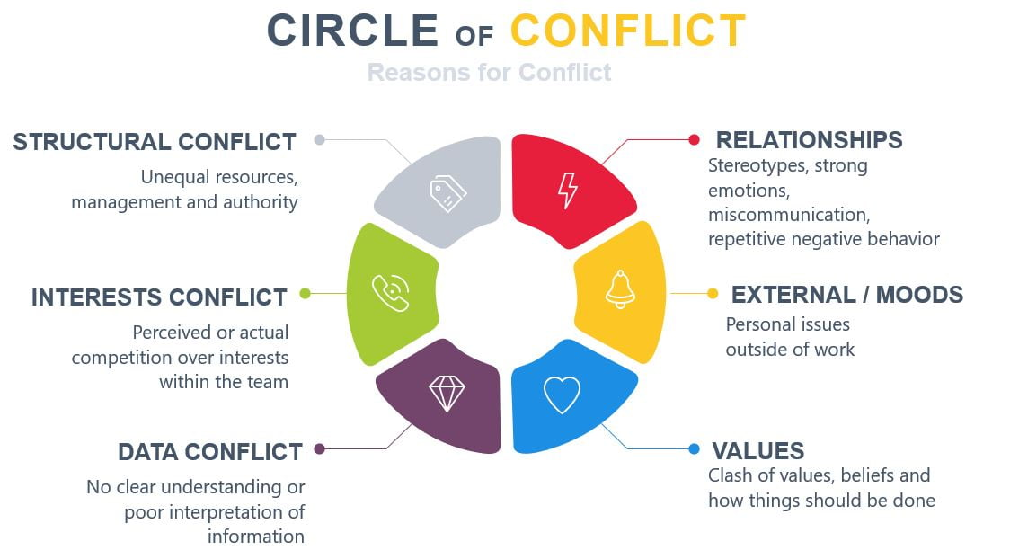

Slide 8
Sources of Conflict
Conflict
Different goals & time horizons
Overlapping Authority
Task Interdependency
Scarce Resources
Incompatible evaluation and Reward
Status inconsistency

Slide 9
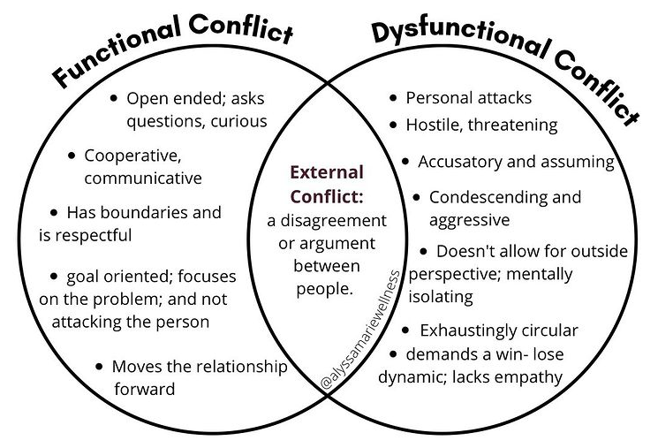
Functional Vs Dysfunctional Conflict

Slide 10
Types of Conflict
Compatible goals
Incompatible goals
Compatible behaviour
No conflict
Latent conflict
Incompatible behaviour
Surface conflict
Open conflict

Slide 11
Compatible goals
Incompatible goals
When goals and behaviour are compatible, there is no conflict
Compatible behaviour
No conflict
Latent conflict
Incompatible behaviour
Surface conflict
Open conflict

Slide 12
Compatible goals
Incompatible goals
Latent conflict is when behaviour is apparently compatible, but goals are not. The latent conflict may need to be brought to the surface to be resolved
Compatible behaviour
No conflict
Latent conflict
Incompatible behaviour
Surface conflict
Open conflict

Slide 13
Compatible goals
Incompatible goals
Compatible behaviour
No conflict
When goals are compatible but behaviour is not, this results in surface conflict. This kind of shallow conflict can often be resolved with good communication
Latent conflict
Incompatible behaviour
Surface conflict
Open conflict

Slide 14
Compatible goals
Incompatible goals
Compatible behaviour
No conflict
Latent conflict
Open conflict is both visible and deep-rooted, emerging from incompatible goals and behaviour
Incompatible behaviour
Surface conflict
Open conflict

Slide 15
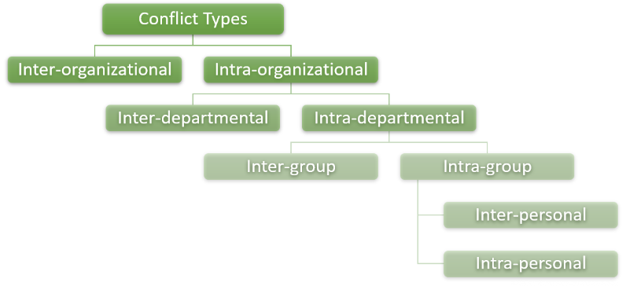
Organisational level of Conflict

Slide 16
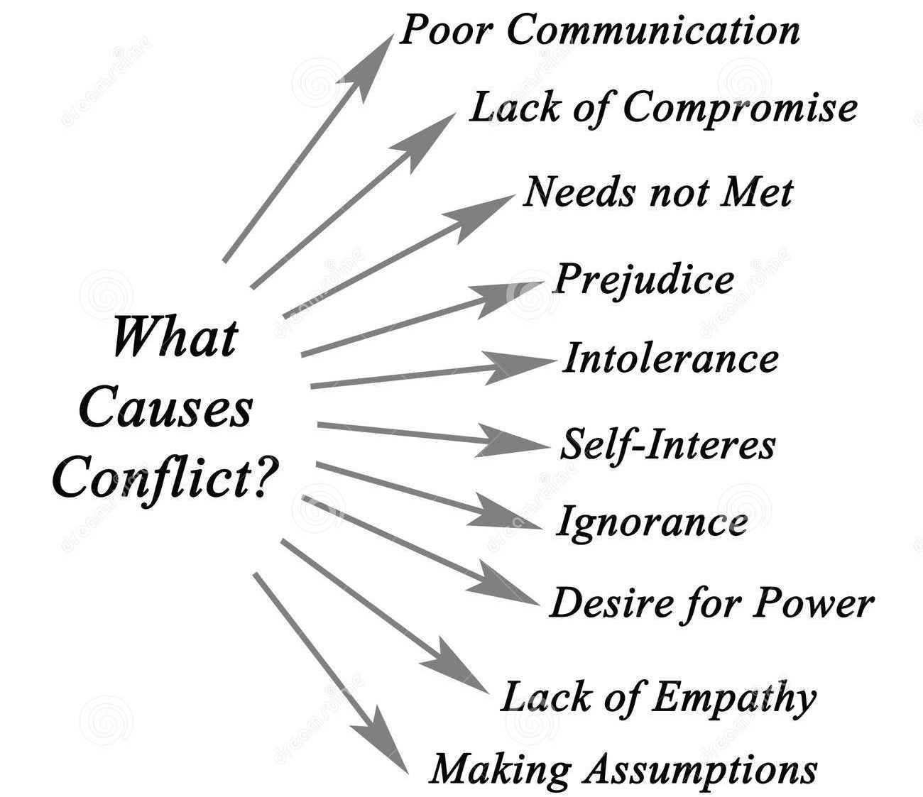

Slide 17
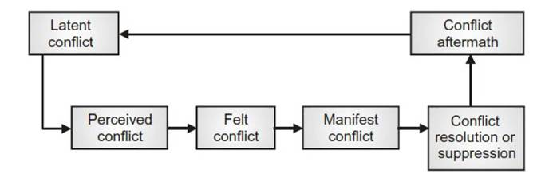
Conflict Management Process / Stages in Conflict

Slide 18
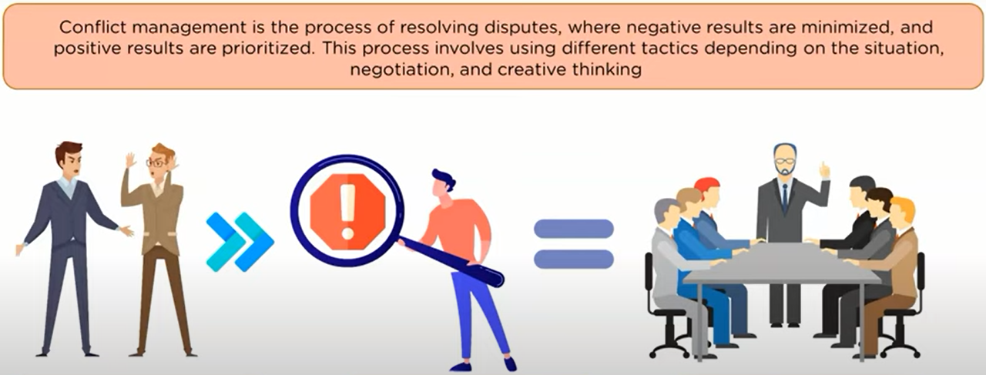
Conflict Management
Different ideas lead to conflict
Analyzing conflicts
Resolving conflicts for a better team

Slide 19
Conflict Management
Conflict Management is the process of limiting the negative aspects of conflict while increasing the positive aspects of conflict. The aim of conflict management is to enhance learning and group outcomes, including effectiveness or performance in organizational setting.

Slide 20
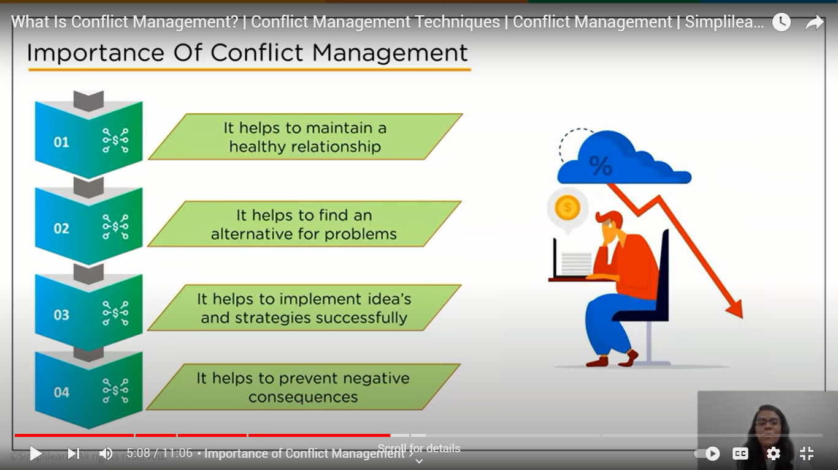
Importance of Conflict Management

Slide 21
Importance of Conflict Management
Conflict management goes a long way in strengthening the bond among employees and half of the problems automatically disappear.
Conflict management also plays an important role in our personal lives.
Conflict management helps to find a middle way, an alternative to any problem and successful implementation of the idea.
Conflict management is very important because it is always wise to prevent a fight at the first place rather than facing its negative consequences.

Slide 22
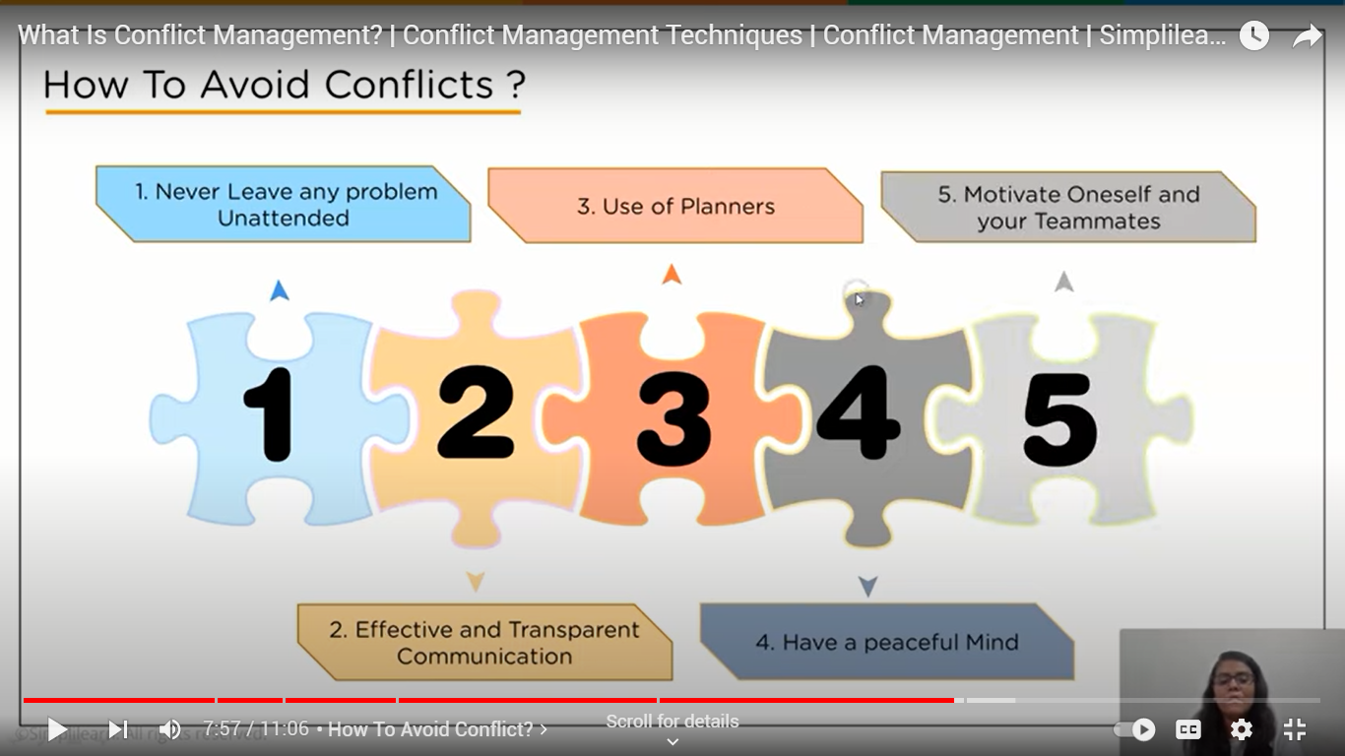
How to avoid Conflict?

Slide 23
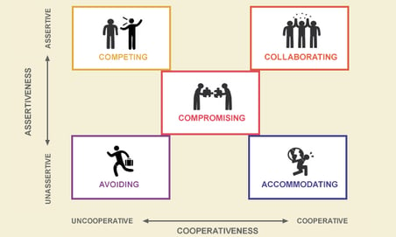
Conflict Management Style / Strategies
According to the Thomas-Kilmann Conflict Mode Instrument, there are 5 styles of conflict management: accommodating, avoiding, compromising, collaborating, and competing.
Which of these strategies are suitable and not suitable for you?

Slide 24
Tips for Managing Conflict
Avoids feelings or perceptions that imply the other person is wrong or needs to change.
Communicates a desire to work together to explore a problem or seek a solution.
Exhibits behavior that is spontaneous and destruction-free.
Identifies with another team member’s problems, shares feelings, and accepts the team member’s reaction.
Treats other team members with respect and trust
Investigates issues rather than taking sides on them.

Slide 25
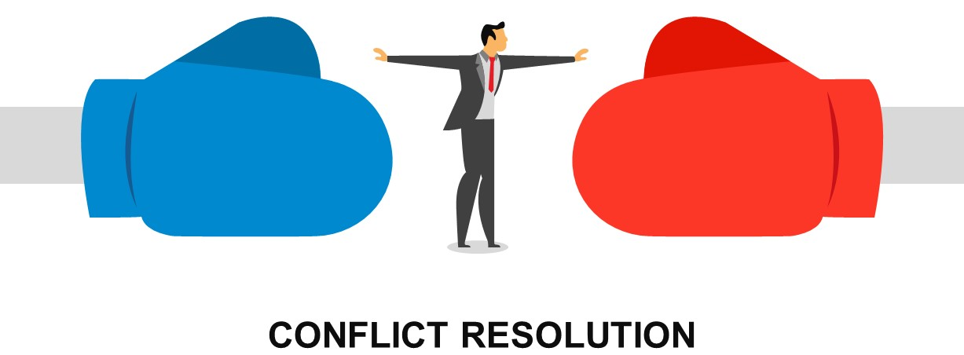

Slide 26
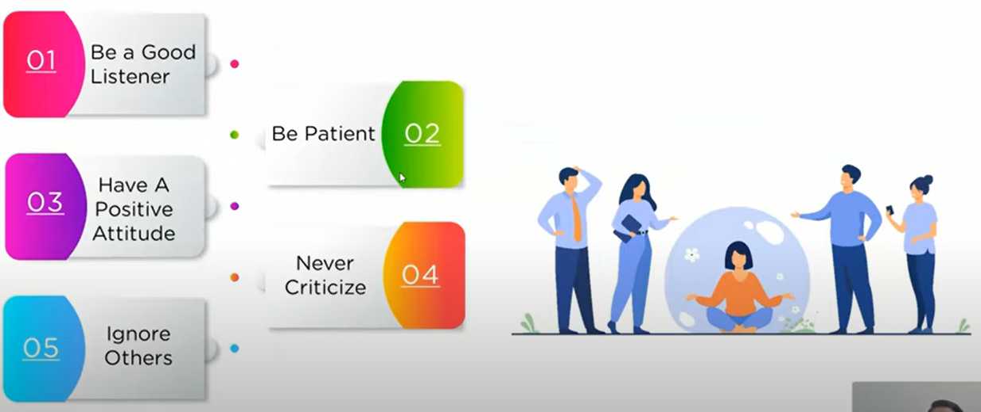
How to Resolve Conflicts?

Slide 27
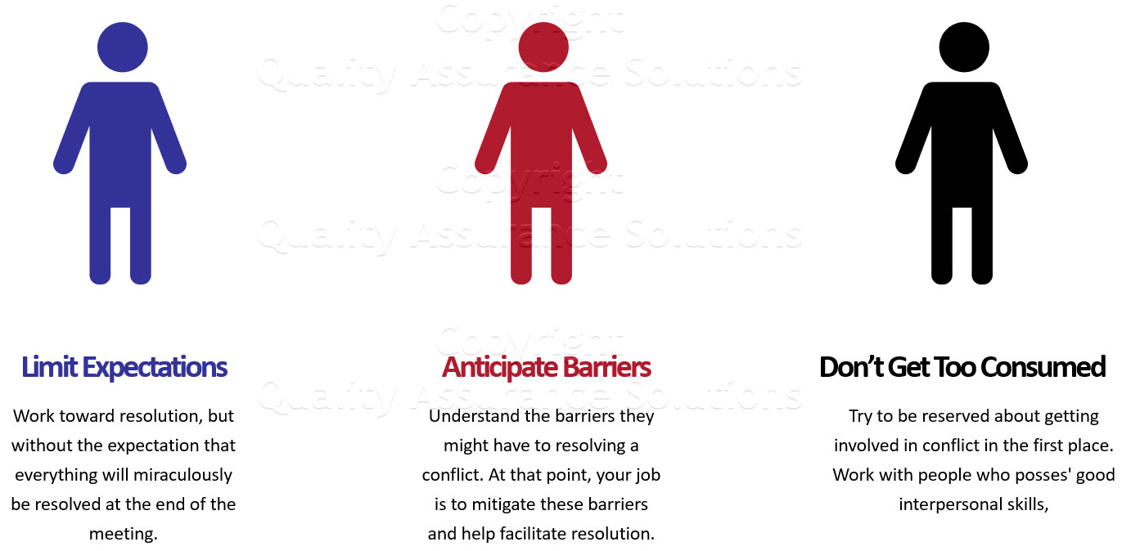
Managing Conflict Resolution

Slide 28
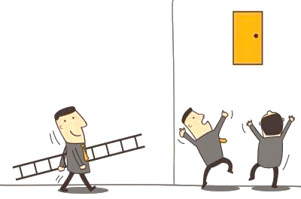
Challenges
21st
Century Challenges

Slide 29

Any Questions

Slide 30

Thank You

